Slide 1

Urban Solutions
Paradigms & Perspectives

Slide 2
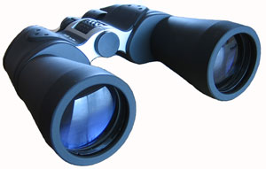
Overview
Many people have tried to reach whole cities for Christ (starting with Jesus and Jerusalem, Paul and Ephesus and so on)
With the rise of the modern city in developing nations (since the 1970s) there has been an increased emphasis on ‘urban ministry’ and a wide variety of approaches - which have been quickly summarized in this presentation
Some of these approaches will suit your particular city / context / theology while others might not
This session will look at some of the major approaches and paradigms so you can be aware of what is going on and what you can “mix and match” for your own ministry

Slide 3
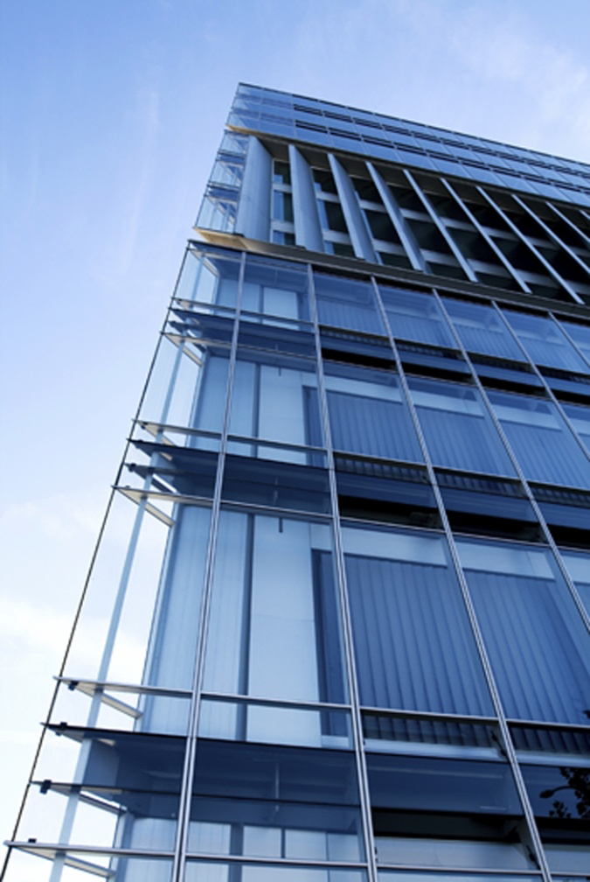
Paradigms…
Urban ministry a Kingdom paradigm big enough to encompass the city as a whole
The paradigm must be post-denominational
The paradigm needs to acknowledge mustard-seed ministries
The paradigm needs to be theologically adequate and visionary enough to drive the various ministries encompassed by it

Slide 4
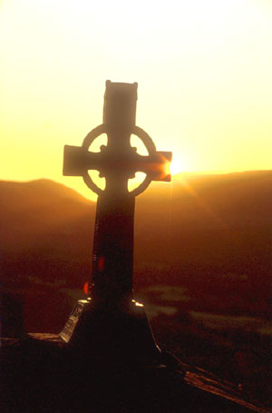
Kingdom of God Paradigm
The Kingdom of God is larger than any one church, denomination or ministry
We should consider the good of the Church as a whole not just our own corner
The city provides the location for inter-church cooperation
Signs and wonders may accompany the arrival of the Kingdom of God
The Kingdom of God is often viewed as a holistic community formed by the preaching of the gospel in a city

Slide 5
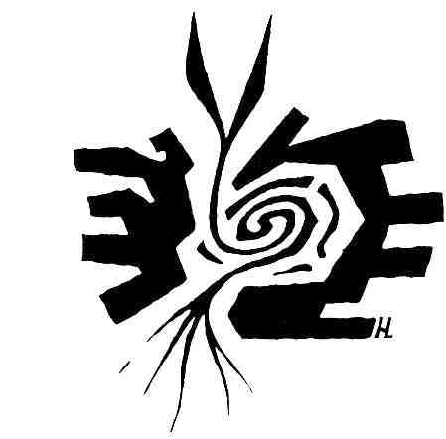
New Creation Paradigm
The Kingdom of God starts in the heart of individuals who become New Creations
They then join the Church which is a New Humanity where Jew and Greek, slave and free are one
The Church then creates revival in the City (polis) such as Jerusalem, Antioch or Ephesus to evangelize the surrounding area. Renewal of the communities of the earth.
This brings a renewed nation into being and, after the return of Christ, a renewal of that natural order, and the New Jerusalem

Slide 6
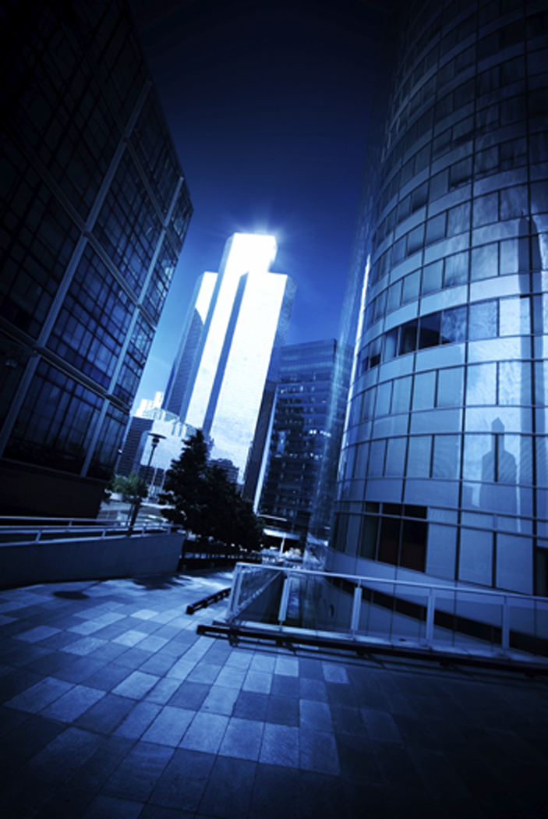
The Wicked City
Jacques Ellul: The Meaning Of The City; Karl Barth
The city is irredeemable and evil and is opposed to God by nature
The City stands for alienation and is without a foundation “It is a city built for itself, without reference to God, as judge or savior.
The city is “works” while rural life is “grace”

Slide 7
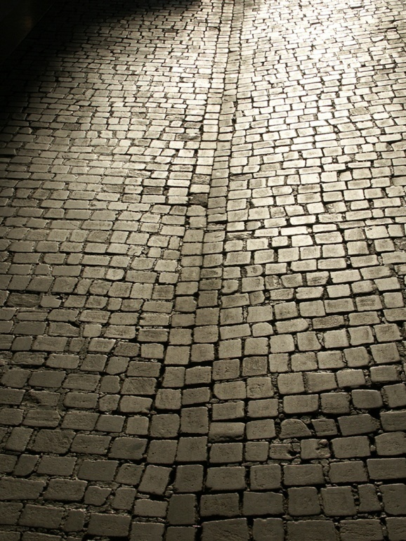
Appreciative Theology
Harvey Cox, Roger Greenway, Ray Bakke
Cities are significant
Cities were the gifts of Yahweh. God gives “great and goodly cities” to his people(Deuteronomy 6:10-12). The city is the place where God dwells, a place of protection and a refuge (Psalm 48).
Cities have a positive spiritual and sociological role
We are to ‘pray for the peace of the city’ (Jeremiah 29:7)
The New Jerusalem is a city

Slide 8
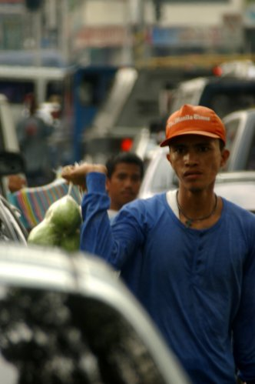
Incarnational Ministry
Viv Grigg builds on the theology of Bakke, Greenway and Cox – cities are a dynamic mixture of good and evil
God is ‘prior’ and owns the city and its structures
Grigg (1996) defines transformation of a city as the “process of bringing God’s kingdom principles to bear on the life and decision-making in the structures and society of a city.”
Missionaries live incarnationally in Asia’s urban slums
Getting involved with the lives of the poor and in transforming grass-roots urban communities
Focus on discipleship, church-planting and on establishing the Kingdom of God

Slide 9

Networked Neighborhoods
Ray Bakke and various US based urban ministries, Theology As Big As The City
Focuses on the inner city in the US context
Racial reconciliation a big issue along with social justice & inner-city issues
Networking, collaboration, tapping into programs and resources, finding solutions together

Slide 10
Social Justice Approach
Focuses on the disparity between rich and poor in the city
In Asia, works for land rights for squatters and matters of sexual exploitation, HIV/AIDS etc.
Also deals with unfair legislation and banking practices
Strong focus on empowerment and on holistic ministry
Often incorporated in other approaches as well

Slide 11
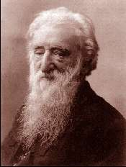
The Rescue Mission
William Booth & the Salvation Army
The city is a sinful place with many temptations
People need to be rescued from the power of sin by the greater power of the gospel
This is done on an individual basis
Basic human needs are also provided as well as programs to treat addictions

Slide 12
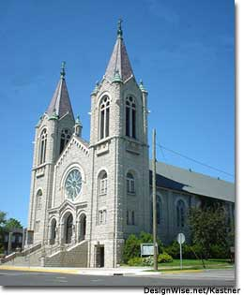
The Church In The City
Works towards increased post-denominational unity of local congregations and pastors
Sees the congregations in the city as part of one organic geographical unity that is highly networked and being brought into unity by the Holy Spirit.
Partly based on the singular being used in Paul’s greetings ‘to the Church which is in Rome’ etc.

Slide 13
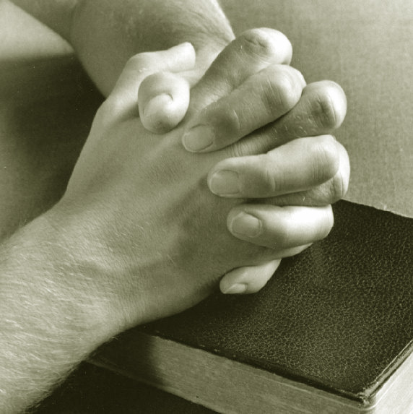
The Spiritual City
Ed Silvoso - That None Should Perish
Brought about revival in Resistencia, Argentina by getting the pastors to pray together in unity, repent etc.
City seen as a entity that must be battled for in prayer and which spiritual forces hold in captivity
Pastors and other leaders such as mayors and police chiefs are spiritual gatekeepers to the city.

Slide 14

Spiritual Mapping
George Otis Jr. and C. Peter Wagner
Researching the history, culture and traumatic events of the city
Trying to locate and bring down demonic strongholds and free the city / neighborhood from oppression
May include prayer walking the city

Slide 15
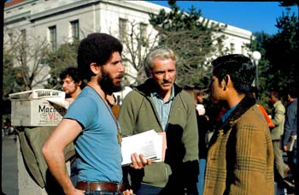
Church Planting
Find a new fast-growing neighborhood and plant a church
Analysis of growth areas and areas most responsive to the gospel and most likely to sustain a church
Training and formation of church-planting teams
In Asian slums it sometimes ends up with numerous small churches lacking a view of the city as a whole
Can also result in mega-churches

Slide 16
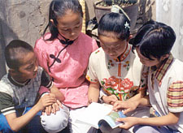
House Churches
Persecution on one hand and problems of getting land / building permits for churches in Asia has led to the rise of house or apartment based churches
In the West disillusionment with the established church has also driven this movement
The city is reached through a network of house churches overseen by an ‘apostolic’ or ‘prophetic’ leader
House churches may even be linked through a web site for doctrine / teaching etc.

Slide 17
Sociological Approach
Qualitative urban research, urban anthropology
City is a collection of interlocked sociological and anthropological groups each with its own dynamic
Nothing (or very little) is as it appears to be on the surface
Requires participative observation techniques in order to understand the various sub-groups in the city

Slide 18
The “Polis”
Max Weber: The City
Polis is the NT Greek word for city and is also the root word for ‘politics’
The city as rooted in its political and cultural life and past history and as the marketplace of ideas
Transformation is through political change and institutional and cultural reform and through the progressive exchange of ideas
Ideas Have Consequences e.g. – cities transformed by the Reformer’s Protestant work ethic
Christians enter into the fray by praying for politicians and entering into public debate and political life.

Slide 19
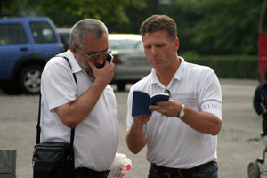
Reaching The Leadership
Student Christian Movement, Inter-Varsity, Navigators…
Reach the leadership of the city while they are at university (which is normally located in a major city)
Personal discipleship of those most likely to be influential
In Asia’s cities may include English lessons, cultural exchange programs etc

Slide 20

Summary
Where there is no church – church planting, incarnational ministry, individual discipleship
Where there are a few ineffective spiritually oppressed churches – spiritual warfare, spiritual mapping,
Where the church is politically oppressed – house churches
Where there are many divided churches – networked churches, cooperation, Kingdom building
Where the Church is ‘missing’ it and losing a generation / neighborhood – the sociological approach
Where there is great injustice – social justice and holistic ministry approaches
Where there are high levels of addiction and promiscuity – the Rescue Mission approach
Where there is relative freedom – the Church can also enter into the political and cultural life and discussions of the city

